Slide 1
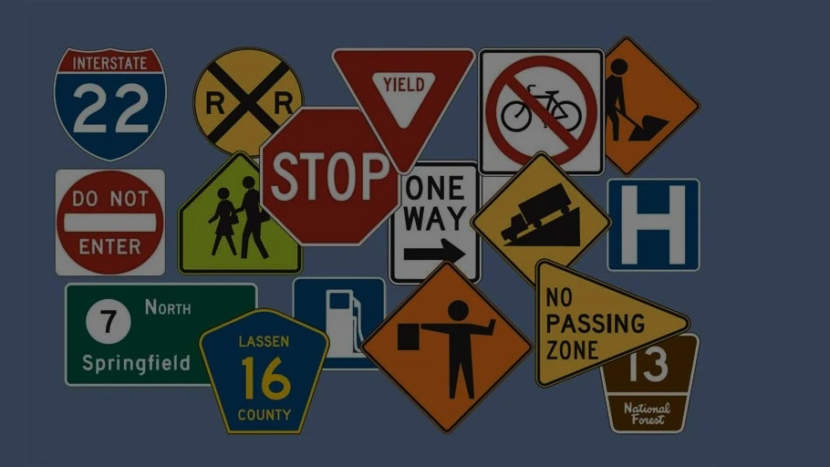
Milestone-3
CNN-Based Road Signs Classification
Indian Traffic Sign Recognition using Deep Learning (CNN)
Presented by:
Sanajikumar S
DA & DS
Febreuary 2025
29-07-2025

Slide 2
Objective: The objective of this project is to develop a CNN-based deep learning model that can accurately classify Indian road signs into 52 categories. This aims to support traffic automation systems, driver assistance, and autonomous vehicle technology. The model is trained on a labeled image dataset with preprocessing, augmentation, and hyperparameter tuning for optimal performance.

Slide 3
Dataset: Indian Traffic Sign Dataset
Total Classes: 52
Image Format: .png/.jpg
CSV Columns:
ClassId: Numeric class label (0 to 51)
Name: Traffic sign description
Examples:
0: Give Way
1: No Entry
52: Refreshments
Dataset Description

Slide 4
1. Data Collection & Preparation
Loaded dataset & label CSV
Resized all images to 64×64
Normalized and Augmented images
2. Model Building
CNN with multiple convolution, pooling, dropout layers
Categorical crossentropy loss
Optimizer: Adam
Methodology

Slide 5
Data
Preprocessing
Converted all images to RGB format
Applied data augmentation:
Rotation, Zoom, Shear, Horizontal Flip
Train-Test Split: 80/20
One-hot encoding for labels
Handled class imbalance via augmentation

Slide 6
CNN Architecture
Input: 64x64x3
Conv Layer 1: 32 filters + ReLU + MaxPooling
Conv Layer 2: 64 filters + ReLU + MaxPooling
Dropout: 0.25
Conv Layer 3: 128 filters + ReLU + MaxPooling
Flatten → Dense (128) → Dropout → Output (52 Softmax)

Slide 7
Training
& Hyperparameters
Epochs: 25
Batch Size: 64
Validation Split: 20%
EarlyStopping & ModelCheckpoint
Data Augmentation Used for Training Generator

Slide 8
Performance Metrics on Test Set:
Accuracy: 88.37%
Precision (Macro): 88.71%
Recall (Macro): 87.33%
F1-Score (Macro): 87.38%
Confusion matrix revealed strong performance across most classes.
Model Evaluation

Slide 9
Sample Predictions
Correctly Classified:
Stop, No Entry, Left Turn
Misclassified:
U-turn ↔️ Roundabout (visually similar)
Plan to visualize Top-3 predicted classes for better transparency

Slide 10
Conclusion & Future Work
Conclusion:
Successfully built a CNN model that can classify 52 Indian traffic signs with high accuracy.
Future Enhancements:
Use deeper CNNs (e.g., ResNet)
Apply Transfer Learning
Deploy via Streamlit or Mobile App (TFLite)
Incorporate real-time video detection

Slide 11
Thank You

